Slide 1
Graph
From http://www.cs.vt.edu/˜shaffer/book.html
And http://www.geeksforgeeks.org

Slide 2
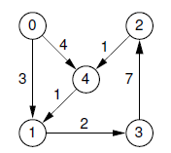
Graph
can model both real-world systems and abstract problems
data structure flexibility
A finite set of vertices also called as nodes
A finite set of ordered pair of the form (u, v) called as edge

Slide 3
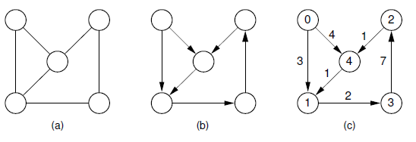
Graph
Graph
Direct Graph
Direct Graph with weight associate with the edge

Slide 4
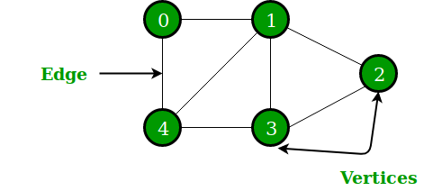
Graph
Graph G = (V, E) consist of
Set of vertices or nodes V
Set of edges E
The most common representation of graph is
Adjacency Matrix – present V
2D array size V x V
Adjacency List – present E
Array of list or linked list
Size equal of the number of vertices or nodes
Represents the vertices adjacent to i^{th} vertex

Slide 5
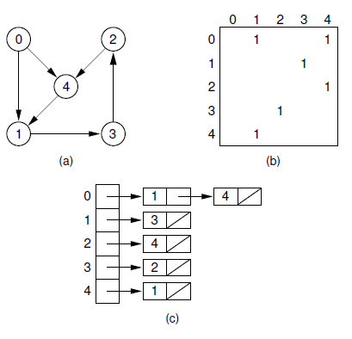
Example Directed Graph

Slide 6
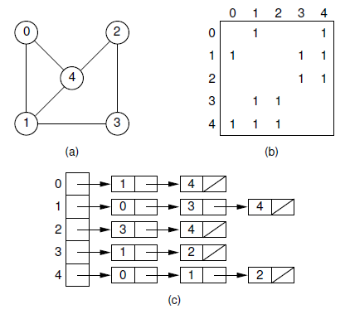
Example Undirected Graph

Slide 7
Application of graph
Computer science : represent the flow of computation.
Google maps : uses graphs for building transportation systems
intersection of two(or more) roads => a vertex
the road connecting two vertices => edge
their navigation system => the shortest path between two vertices.
Facebook : Friend suggestion
users => vertices
if they are friends then there is an edge running between them
Operating System : Resource Allocation Graph
each process and resources => vertices
resources to the allocated process / requesting process to the requested resource=> Edge
https://www.geeksforgeeks.org/applications-of-graph-data-structure/

Slide 8
Example Code
https://www.geeksforgeeks.org/graph-and-its-representations/
More graph information
https://www.geeksforgeeks.org/mathematics-graph-theory-basics-set-1/
https://www.geeksforgeeks.org/mathematics-graph-theory-basics/
https://www.geeksforgeeks.org/graph-types-and-applications/

Slide 9
Traversal
Binary Tree Traversal
How to access to all nodes in tree

Slide 10
Depth First Search
Go to depth node in one side then go to another side
Three rules
Pre-order traversal
node > left child node > right child node
In-order traversal
left child node > node> right child node
Post-order traversal
left child node > right child node > node
Implement with stack

Slide 11
Pre-order traversal

Slide 12
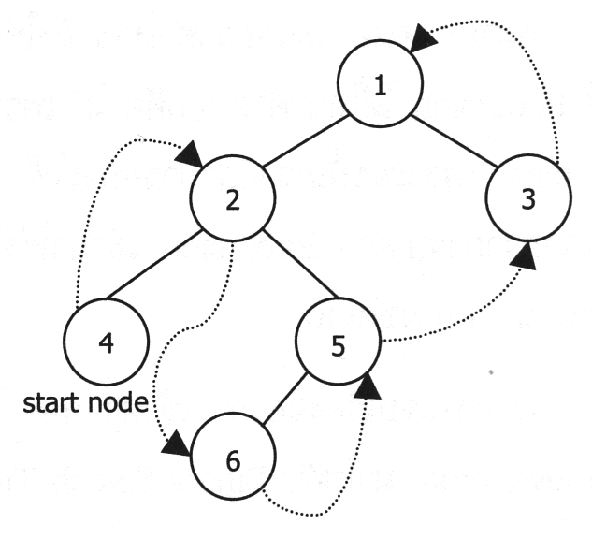
In-order traversal

Slide 13
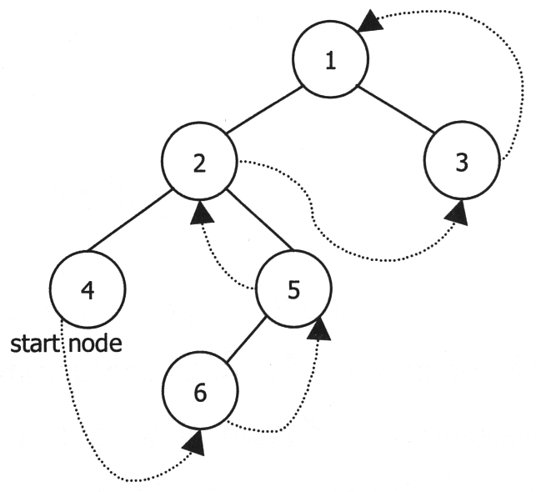
Post-order traversal

Slide 14
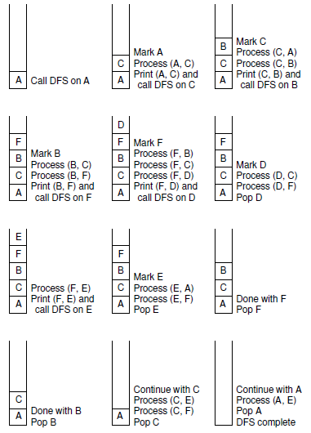
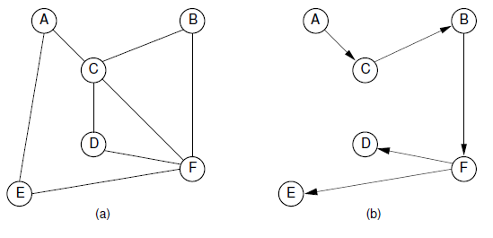
Graph: Depth first search

Slide 15
Example Code
C
https://www.programiz.com/dsa/graph-dfs
https://www.thecrazyprogrammer.com/2014/03/depth-first-search-dfs-traversal-of-a-graph.html
C++
https://www.geeksforgeeks.org/depth-first-search-or-dfs-for-a-graph/
Problems https://www.geeksforgeeks.org/top-10-interview-question-depth-first-search-dfs/

Slide 16
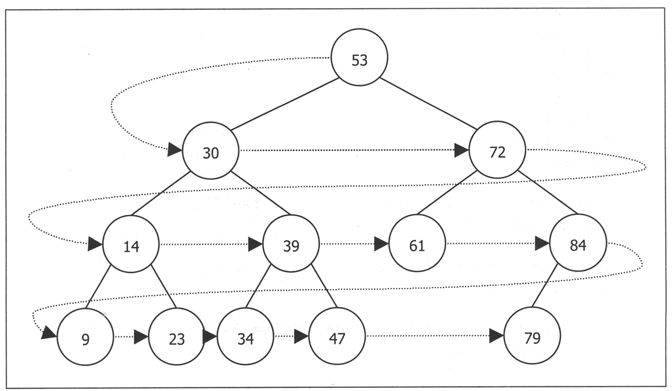
Breadth first search
examines all vertices connected to the start vertex before visiting vertices further away
Tree : may be called level order traversal
Implement with queue

Slide 17
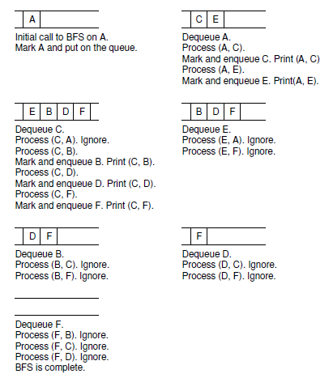
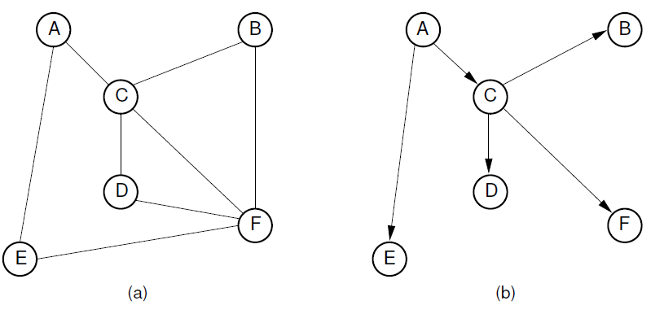
Breadth first search

Slide 18
Example
C
https://www.tutorialspoint.com/data_structures_algorithms/breadth_first_traversal_in_c.htm
https://www.thecrazyprogrammer.com/2015/09/breadth-first-search-bfs-program-in-c.html
C++
https://www.geeksforgeeks.org/breadth-first-search-or-bfs-for-a-graph/
Application
https://www.geeksforgeeks.org/applications-of-breadth-first-traversal/

Slide 19
Animation
DFS
https://www.youtube.com/watch?v=NUgMa5coCoE
https://www.youtube.com/watch?v=GFlthbUd7LQ
BFS
https://www.youtube.com/watch?v=x-VTfcmrLEQ
https://www.youtube.com/watch?v=hnzkJv3y2ag

